Slide 1
Reducing the Wrapping Effect in Flowpipe Construction using Pseudo-Invariants
Stanley Bak
United States Air Force Research Lab
Information Directorate – Rome, NY

Slide 2
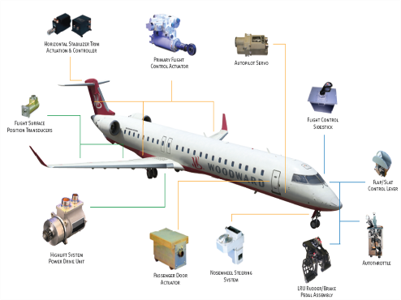
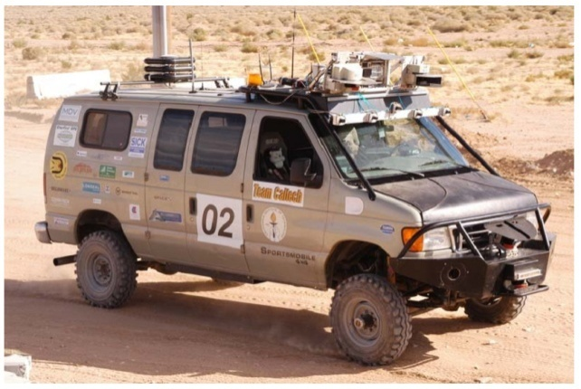
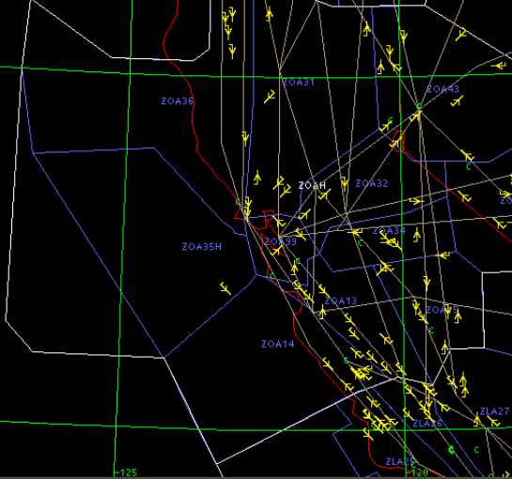
Cyber-Physical Systems
Include computational (discrete) components, and physical-world (continuous) aspects
Discrete components are typically modeled using
finite state machines with switching rules. The physical world is typically described by differential equations.
Fault-Tolerant
Power Distribution
Autonomous Cars
Air Traffic Control

Slide 3
Outline
Hybrid Automata as Models for Cyber-Physical Systems
Flowpipe Construction
Wrapping-Effect Error
Pseudo-Invariants
Improvement Example

Slide 4
Hybrid Automaton
Fusion of discrete dynamics with continuous dynamics
location
(discrete state)
guard condition
edge
u’
u
reset condition
invariant: hybrid automaton may remain in u as long as x ∈ I(u)
initial condition
continuous dynamics
From: “Hybrid System Verification Using Discrete Model Approximations,” Chutinan

Slide 5
Hybrid Automaton Example
Simple example: on/off heater in a room
(x = temperature)

Slide 6
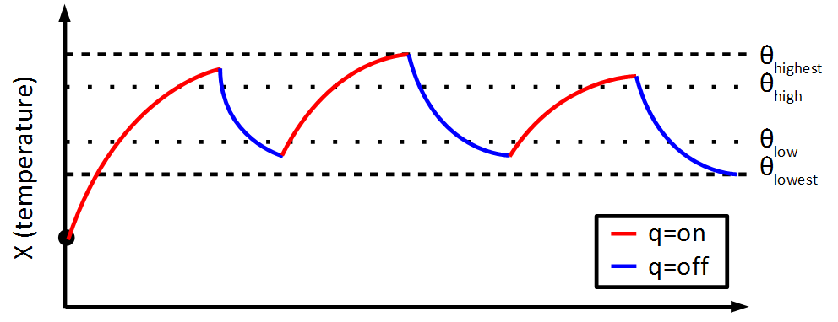
Hybrid Automaton Execution
Executions of a hybrid automaton capture one valid trajectory in the model. There can be unaccountably many.

Slide 7
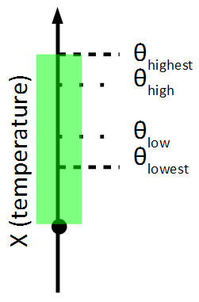
Hybrid Automaton Reachability
Reachability captures all possible behaviors, and is therefore useful for verification.

Slide 8
Outline
Hybrid Automata as Models for Cyber-Physical Systems
Flowpipe Construction
Wrapping-Effect Error
Pseudo-Invariants
Improvement Example

Slide 9
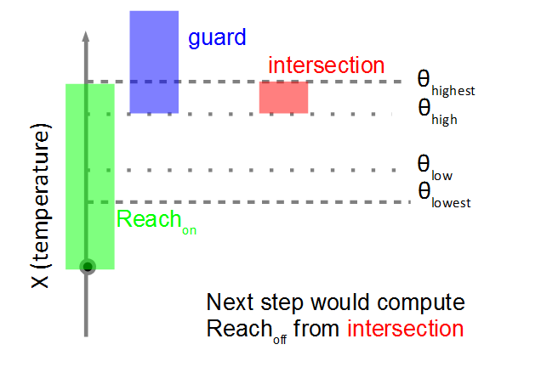
Reachability Algorithm
One way to (overapproximate) reachability is to iteratively compute discrete and continuous successors

Slide 10
Continuous Successors
Many ways to compute continuous successors (abstraction, symbolic reasoning, flowpipe construction)
Flowpipe construction methods compute the set of states at snapshots in time
Between 0.0 and 0.1
T=0.0
Between 0.1 and 0.2
T=0.1
T=0.2

Slide 11
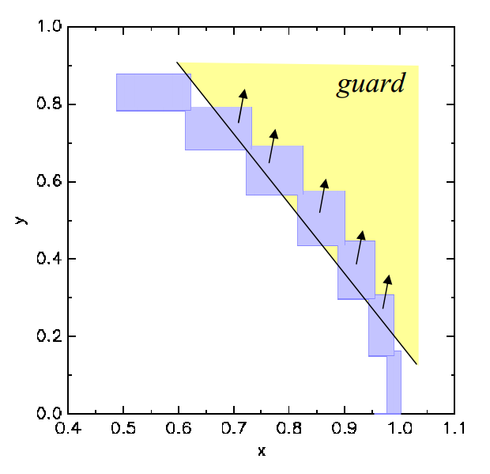
Discrete Successors
Flowpipe methods typically aggregate states across discrete transitions
Otherwise, a single
tracked set can
spawn multiple
flowpipes in
subsequent modes
Image from: “Safety Analysis of Hybrid Systems with SpaceEx,” Frehse et al., http://cmacs.cs.cmu.edu/seminars/slides/frehse.pdf

Slide 12
Demonstration
(buck_open.hyc)
Aggregation

Slide 13
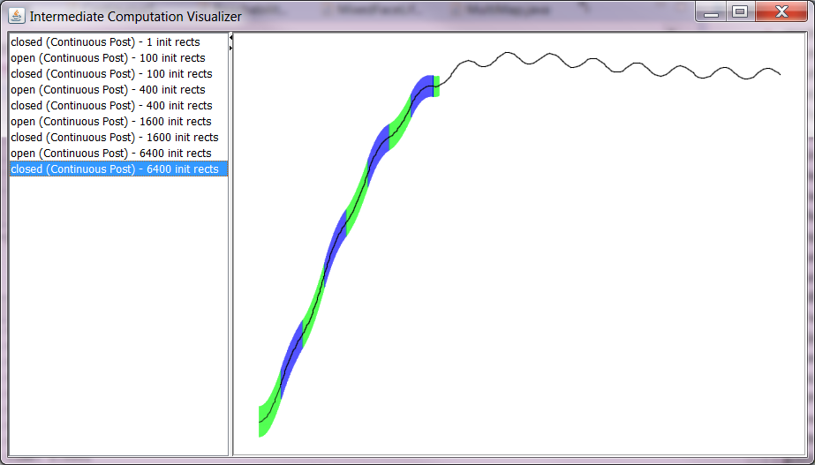
No Aggregation

Slide 14
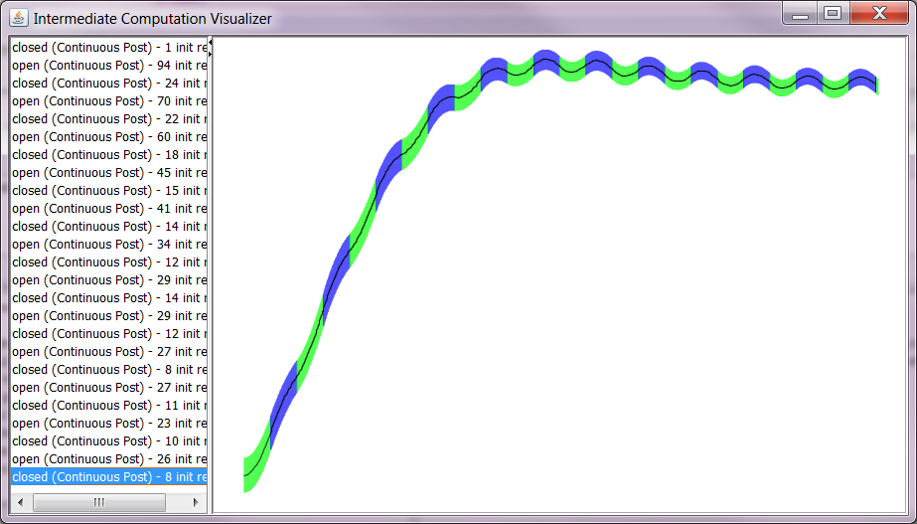
With Aggregation

Slide 15
Outline
Hybrid Automata as Models for Cyber-Physical Systems
Flowpipe Construction
Wrapping-Effect Error
Pseudo-Invariants
Improvement Example

Slide 16
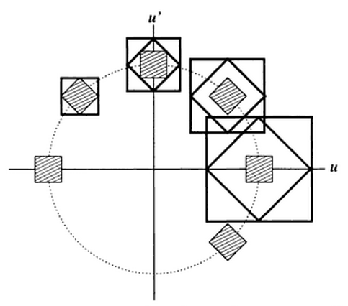
Flowpipe Construction Issues
Iterative flowpipe construction leads to overapproximation error
Depends on representation
Image from: “Perspectives on Enclosure Methods”, Kulisch et al.

Slide 17
Outline
Hybrid Automata as Models for Cyber-Physical Systems
Flowpipe Construction
Wrapping-Effect Error
Pseudo-Invariants
Improvement Example

Slide 18
Pseudo-Invariants
Key Idea of the Talk: Use discrete successor aggregation to reduce wrapping-effect error
How? Force discrete-successor aggregation to occur by introducing an artificial invariant (called the pseudo-invariant) and associated transition
  Basically, split one mode into two with
  identical dynamics

Slide 19
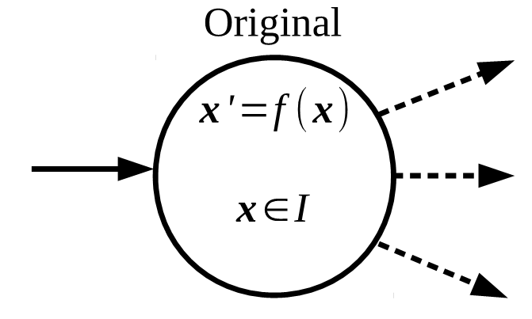
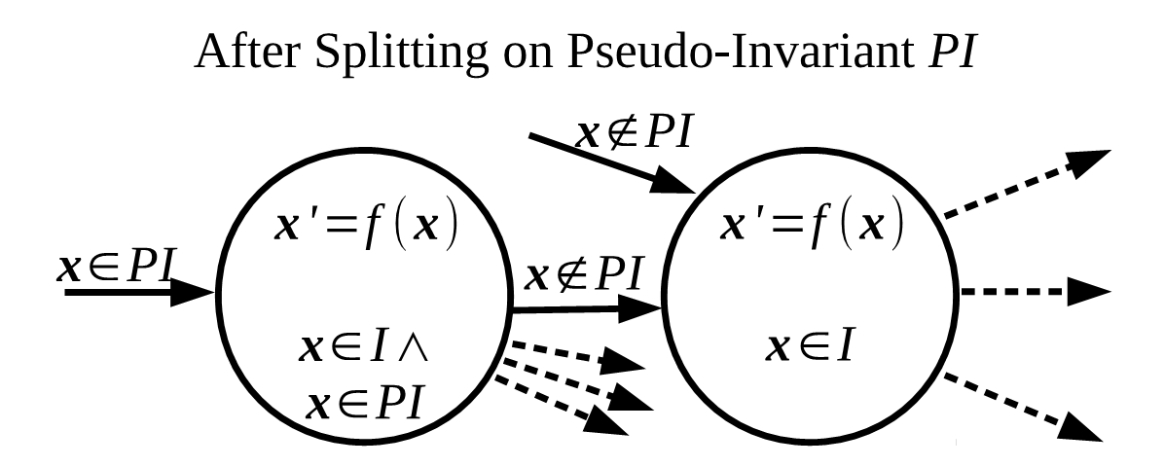
Splitting a Single Mode
The new automaton is a bisimulation of the original one

Slide 20
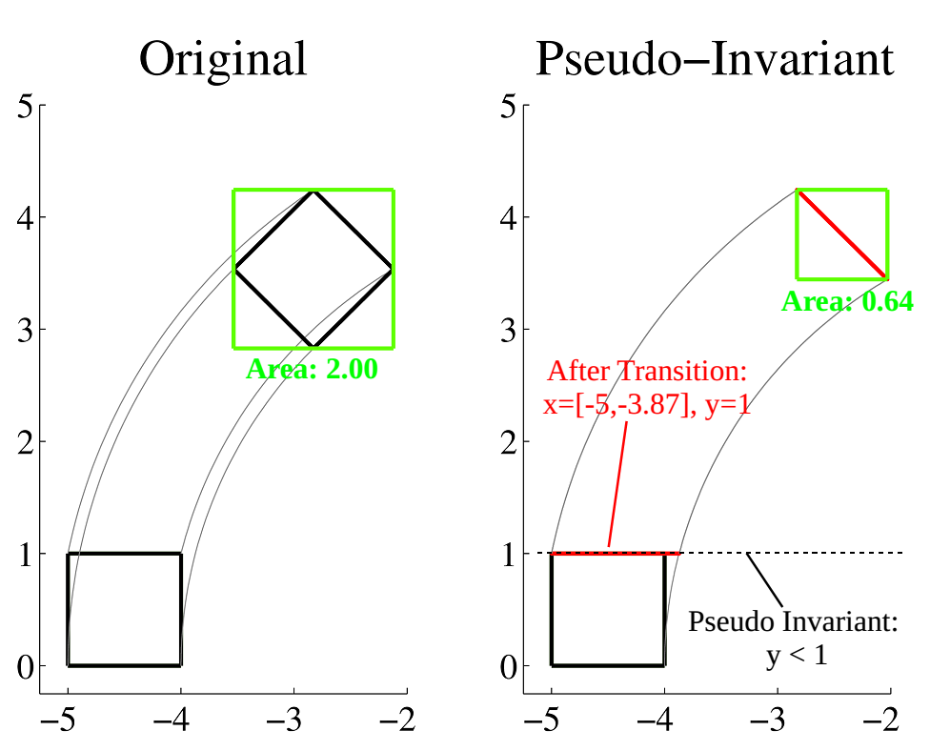
Effect on Reachability

Slide 21
Outline
Hybrid Automata as Models for Cyber-Physical Systems
Flowpipe Construction
Wrapping-Effect Error
Pseudo-Invariants
Improvement Example

Slide 22
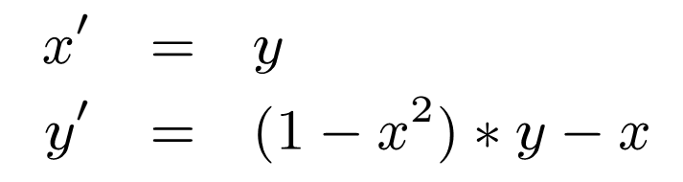
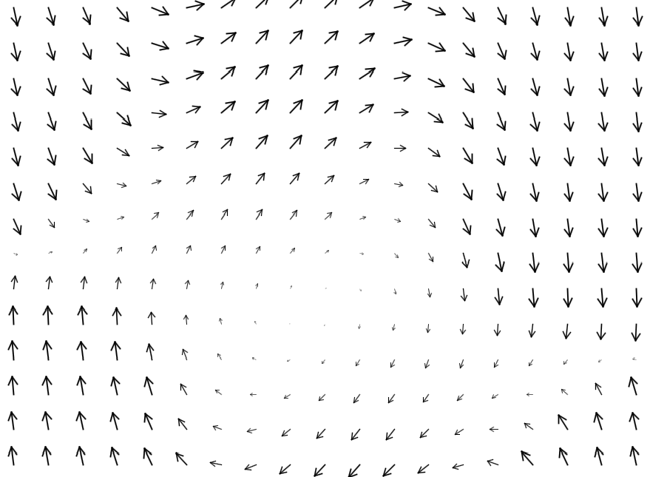
Van der Pol Dynamics
(Demonstration, ShowReachability.jar)

Slide 23
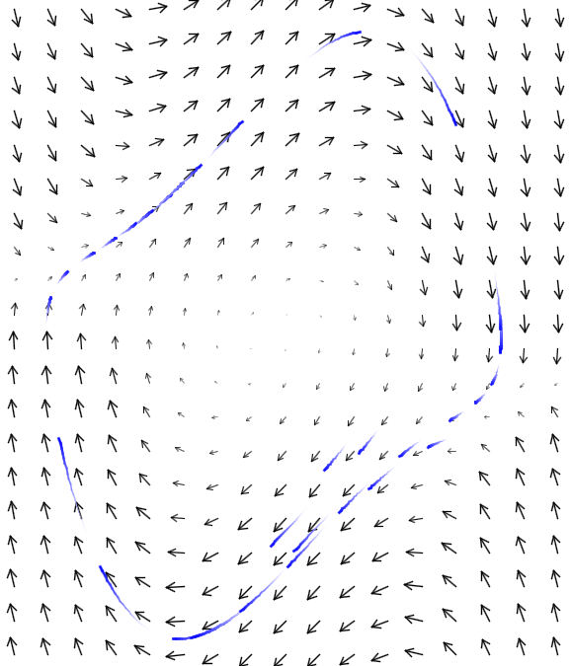
Van der Pol Simulations

Slide 24
Computing Reachability
Using Flow*, a reachability tool that uses Taylor Models as a state-set representation, we ran the following two models (initial state: x = 1.0, y=[-0.5, 0.5]):
first { poly ode 1 {
x'= y
y'= y - x - x^2 * y
}
inv { x in [0.75, 999] } }
second { poly ode 1 {
x'= y
y'= y - x - x^2 * y
}
inv {}}
jumps { first -> second
guard { x in [-999,0.75] }
reset { }
parallelotope aggregation {}}
poly ode 1 {
x'= y
y'= y - x - x^2 * y
}
Error gets too large
at t=1.54, tool exits
Completes
Successfully!

Slide 25
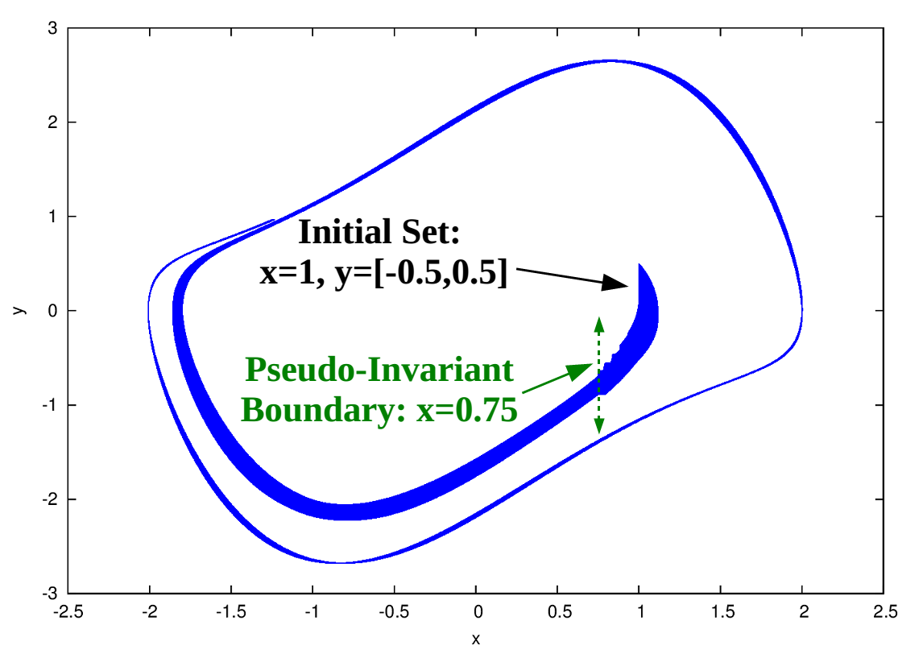
Flow* Reachability

Slide 26
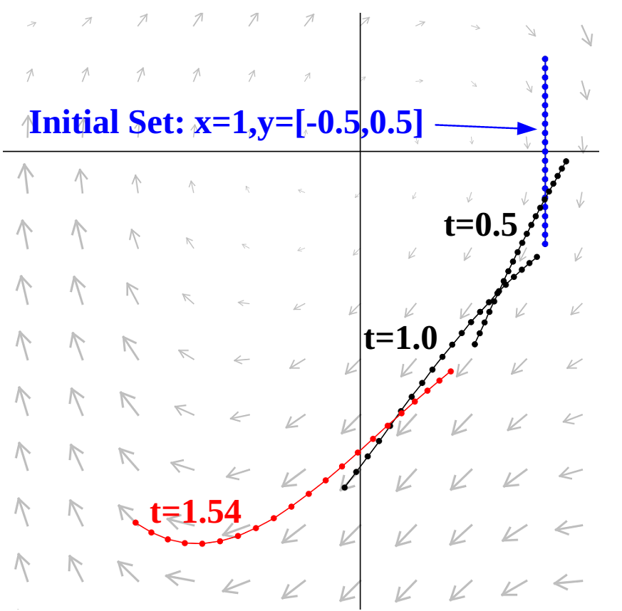
What Happens Around t=1.54?

Slide 27
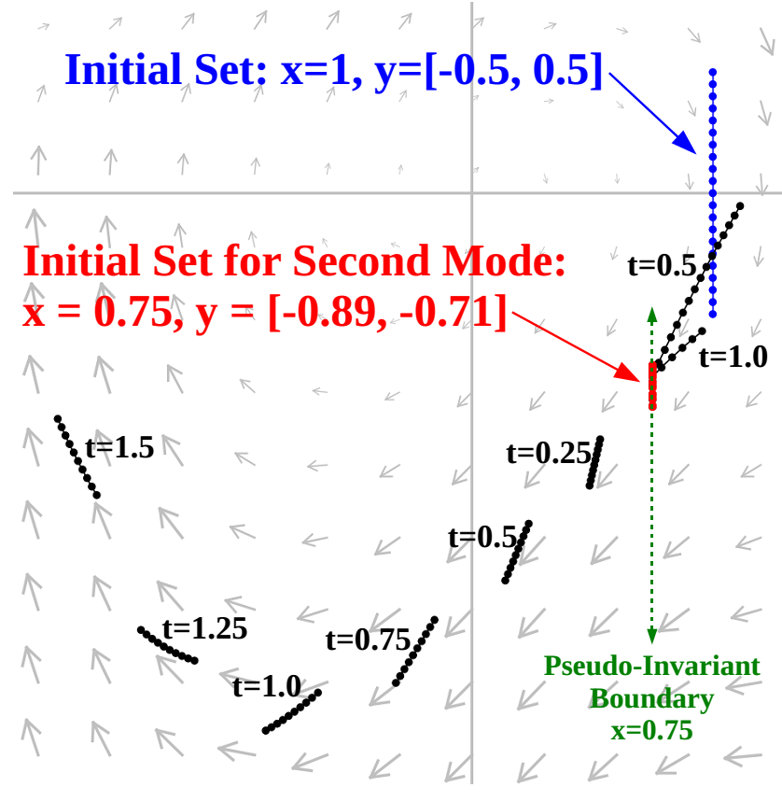
With Pseudo-Invariant

Slide 28
Conclusion
Key Idea of the Talk: Use discrete successor aggregation to reduce wrapping-effect error
Concerns:
  What if the intersections are not accurate?
  How do you come up with pseudo-invariants?
  What if you choose a “poor” pseudo-invariant?

Slide 29
Bonus
How do you come up with pseudo-invariants?
Idea: during reachability, when the wrapping errors appears to be getting large, generate a pseudo-invariant on-the-fly based on the currently-tracked set
(demonstration, van_der_pol.hyc)

Slide 30
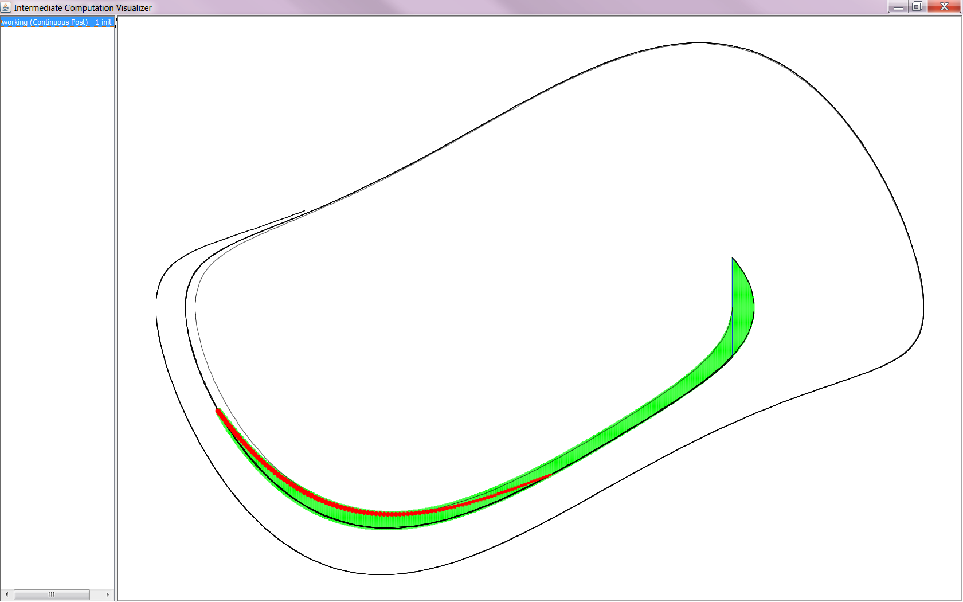
Without Pseudo-Invariants

Slide 31
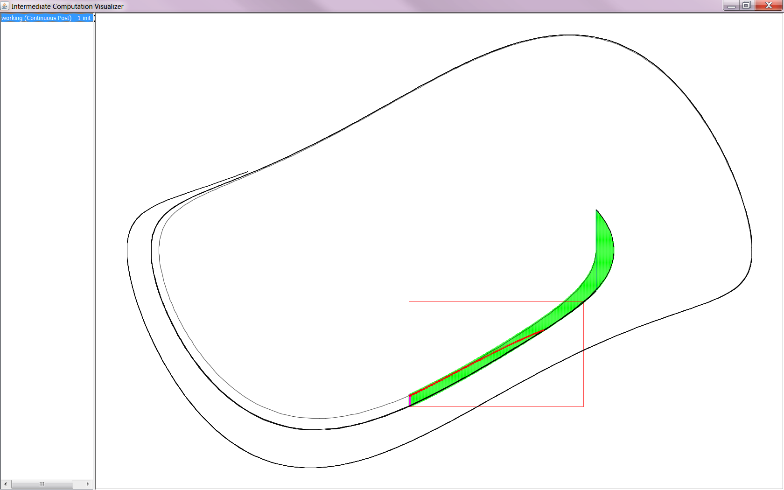
Using Pseudo-Invariants

Slide 32
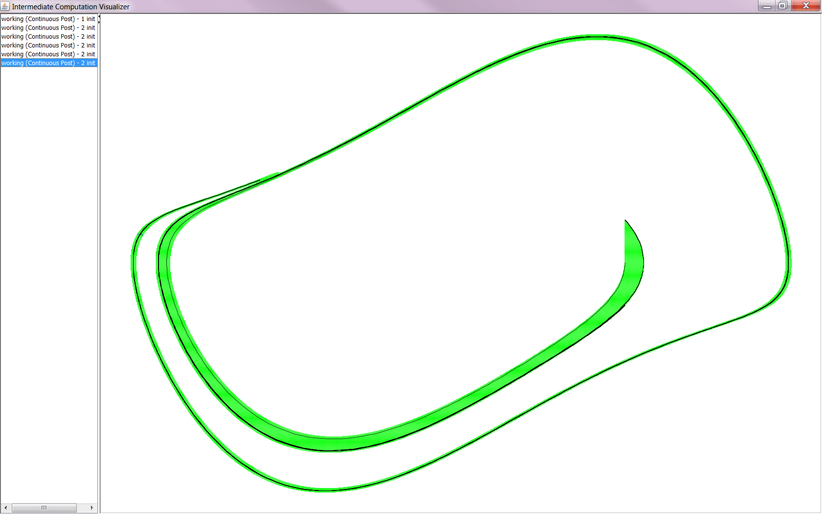
Using Pseudo-Invariants (2)

